Slide 1
Task 4 – Coffee - sales Dashboard
Interactive Sales Dashboard using Tableau
Divya Parthasarathy
Data Analyst Intern

Slide 2
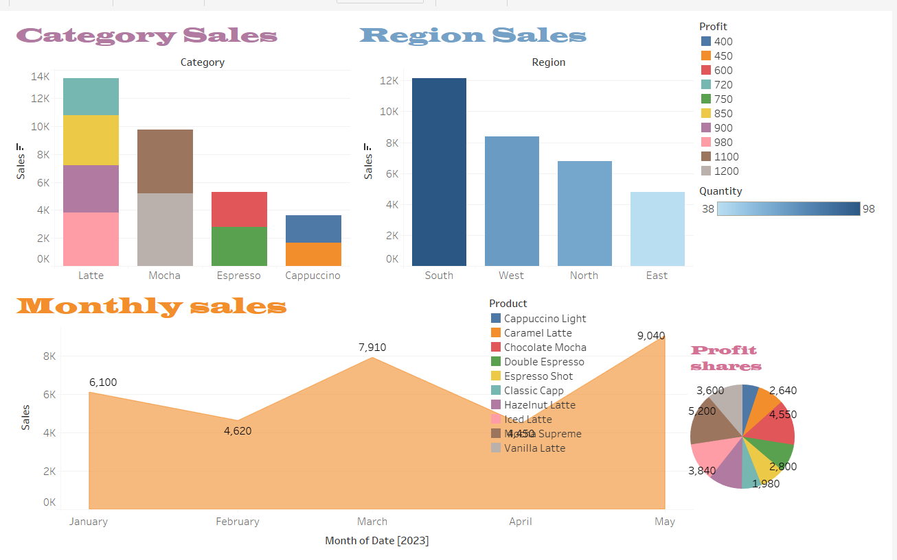
Dashboard Screenshot

Slide 3
KPI Summary
• Total Sales: ₹32,120
• Total Profit: ₹6,408
• Total Quantity: 1,285

Slide 4
Insights
• Latte is the top-selling product category.
• South region records the highest sales.
• March and May had peak monthly sales.
• Caramel Latte leads in overall profit share.
• Category-wise performance shows strong seasonal trends.

Slide 5
Tools & Learnings
• Tools Used: Excel, Tableau Public, GitHub, PowerPoint
• Built interactive dashboards using filters and slicers.
• Applied KPI cards for business summary.
• Improved storytelling using visuals and insights.

